Slide 1





CAN DO Menopause Twitter: @MyPause1 Section 1 TITLE: Providing Support
This event is hosted by MyPause, menopause support group, Suffolk and North East Essex Integrated Care System, and Hertfordshire and West Essex Integrated Care System

Slide 2
Menopause and the Law
If an employee or worker is put at a disadvantage or treated less favourably because of their menopause symptoms, this could be discriminatory if connected to a protected characteristic.
Equality Act 2010, which protects workers against discrimination
The menopause is not a specific protected characteristic under the Equality Act 2010. But if an employee or worker is put at a disadvantage and treated less favourably because of their menopause symptoms, this could be discrimination if related to a protected characteristic, for example:
age
disability
gender reassignment
Sex
Health and Safety at Work Act 1974, which says an employer must, where reasonably practical, ensure everyone's health, safety and welfare at work Source: acas.org.uk

Slide 3
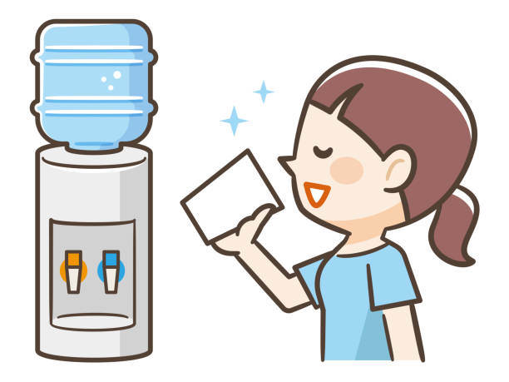
What can I do as a Manager? Environment
Access to water and suitable rest room
Temperature/ventilation
Uniform
Reasonable adjustments
Not worsening the symptoms

Slide 4

What can I do as a Manager? - Leadership
Educate yourself on the symptoms (not all people experience all symptoms, different levels of support)
Pay attention – listen
Ask questions
Don’t personalise symptoms
Consider their needs
Approach things together
Be aware of anxiety and sleeplessness
Eliminate stigma and taboo

Slide 5

What can we do as an organisation? Sign up, support, educate
Ability to listen and talk sensitively
Do not personalise symptoms
No stigma or taboo

Slide 6

RESOURCES
Acas.org.uk:
Supporting staff through the menopause
Talking with staff about the menopause
Menopause and the law
https://www.menopausematters.co.uk/manshed.php

Slide 7
CAN DO Menopause Twitter: @MyPause1 Section 2 TITLE: Inclusive Menopause
This event is hosted by MyPause, menopause support group, Suffolk and North East Essex Integrated Care System, and Hertfordshire and West Essex Integrated Care System

Slide 8

Inclusive Menopause – BAME
Although menopause is biologically similar with all ethnic groups, things like culture, lifestyle, economy can effect the way it is experienced
In Punjabi & Urdu there is no word that directly translates as ‘menopause’
Symptoms may be expressed differently, or English may not be a first language, causing to no or mis- diagnosis
Low uptake of HRT
Health care is white male largely by default, e.g. vitamin D

Slide 9

Inclusive Menopause – LGBTQIA+
Menopause is experienced by cisgender women and also trans men and non-binary and intersex people
People who are mis-gendered may avoid accessing beneficial healthcare
Perimenopause and menopause can exacerbate any existing mental or physical health issues
Health check invitations by gender not need, e.g. breast and cervical screening
Depravation/poverty
Supplements, targeted toiletries, over the counter treatments are expensive

Slide 10
RESOURCES
PODCASTS
Black Girls’ Guide to Surviving Menopause Gender inclusive podcast and guide presented by leader, facilitator and healer Omisade Burney-Scott.
Black Menopause and Beyond Podcast with Anita Powell
Menopause Whilst Black Podcasts about Black British women’s experiences of menopause, hosted by Karen Arthur (intro here).
SITES & GROUPS
All-Gender Peri/Menopause page Facebook group run by Heather Corinna.
Black Women in Menopause Events, support and information, created by Nina Kuypers (founder of Black Health and Beyond).
People Who Menstruate Stories about menstruation, pregnancy, menopause and more from trans men, non-binary and intersex people. Introduction here. Guide to Menopause for Women Living with HIV Guide created by Sophia Forum.
My Premature Menopause Hayley Cockman’s story of experiencing menopause at 14.
Book: What Fresh Hell is This? – Heather Corinna

