Slide 1
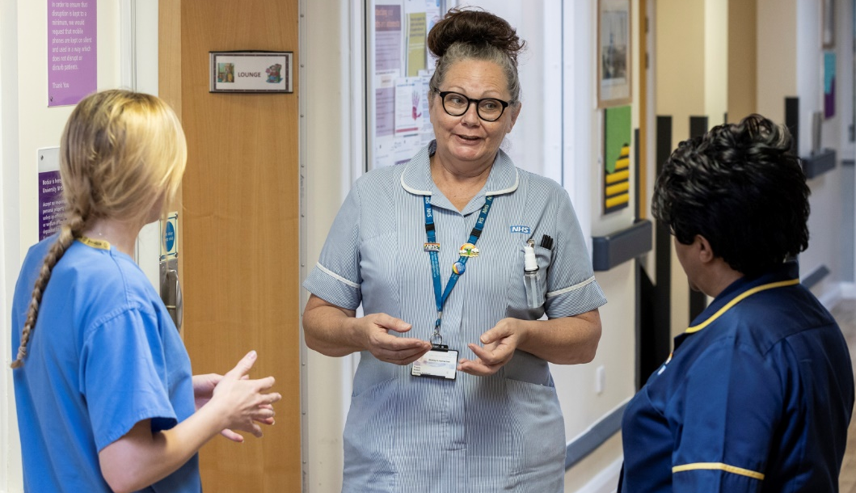

EPUT EDUCATION TEAM
HEALTH AND SOCIAL CARE APPRENTICESHIPS PATHWAY
Health and Social Care Level 3- Senior Healthcare Support worker
The criteria to apply is Completed Care certificate , Maths and English would be advantageous at GCSE grade C or above, or grade 4 – 9, Functional Skills Maths and English Level 2. However if you do not have this you can undertake the Functional skills qualification alongside your apprenticeship
Duration 18 months plus EPA
Forward study leave applications to denise.whickman@nhs.net to with certificates (applications will not be processed without certificates)
To discuss course content further contact kimberley.allen1@nhs.net Rose.rushbrook.nhs.net or Sandra.taylor.nhs.net
Assistant Practitioner (Higher National Diploma in Health Care Practice) Foundation Degree Level 4/5
The criteria to apply is Health and Social Care Level 3 or equivalent in a science related subject, GCSE grade C or above, or grade 4 – 9, Maths and English or Functional Skills Maths and English Level 2. Completed Care certificate if in post
Duration 24 months plus EPA
Forward study leaves applications to DeniseWhickman@nhs.net with copies of your certificates of study.
To discuss course content contact James.rushbrook@nhs.net YvonneHawkins@nhs.net Kelly.Marsden@nhs.net Paula.white12@nhs.net

